Slide 1
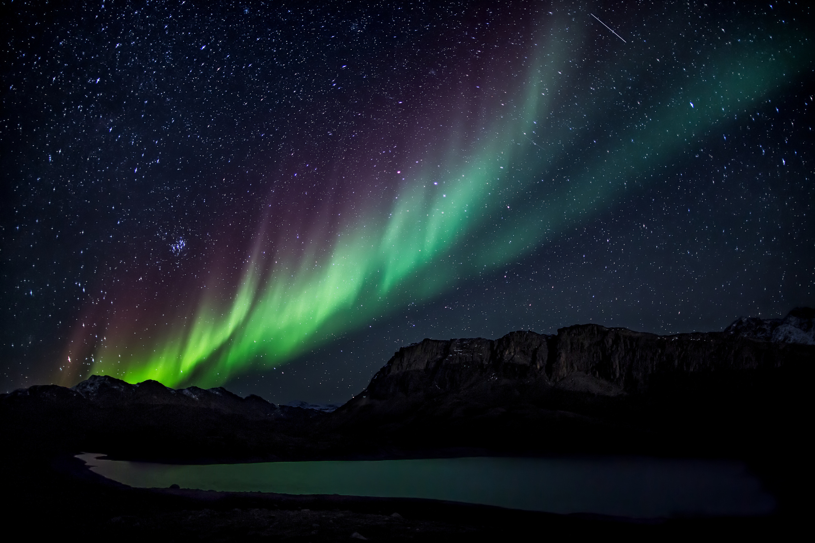

NGHS STUDENT
SERVICES DEPARTMENT PRESENTS
Northern
Lights II
SPOTLIGHTING ALL THINGS SENIOR YEAR

Slide 2

NGHS VISION STATEMENT
Northern Guilford High School will equip and prepare all graduates with a career plan, apprenticeship, enlistment agreement, or acceptance letter to a post-secondary school.

Slide 3
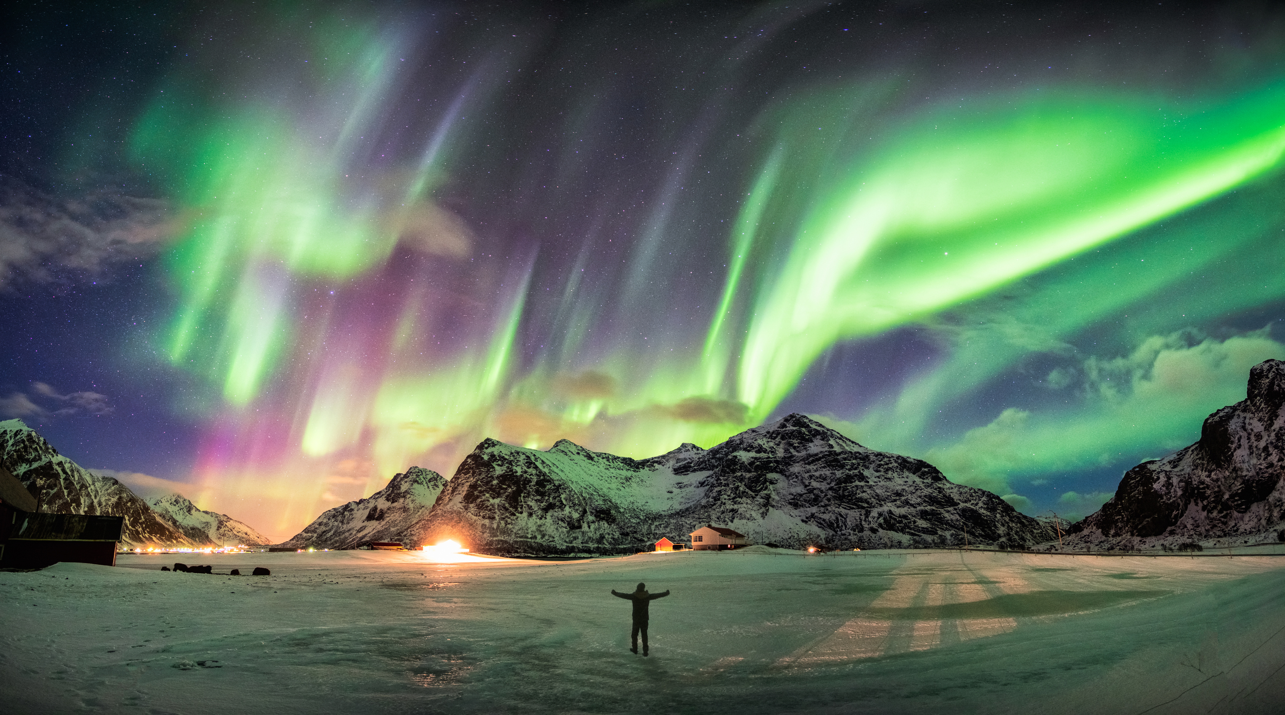
IMPORTANT DATES:
3/18 Senior Meeting
3/19 Herff Jones senior delivery
3/31 Last day for Service Learning pre-approval submissions
4/1 Legacy Brick purchase deadline
4/5 Prom
4/14-18 Spring Break
4/21 Decision Day videos due
4/21 Last day to submit & verify Service Learning
5/1 Decision Day Senior Lunch
5/2 Graduation Walks
6/1 Senior Awards/Picnic and Sunset
6/10 Graduation Rehearsal
6/13 Graduation

Slide 4
3/31 - Last day for pre-approval submissions
4/21 - Last day to have submissions entered and verified in X2Vol for credit towards awards/diplomas.

Slide 5


Slide 6

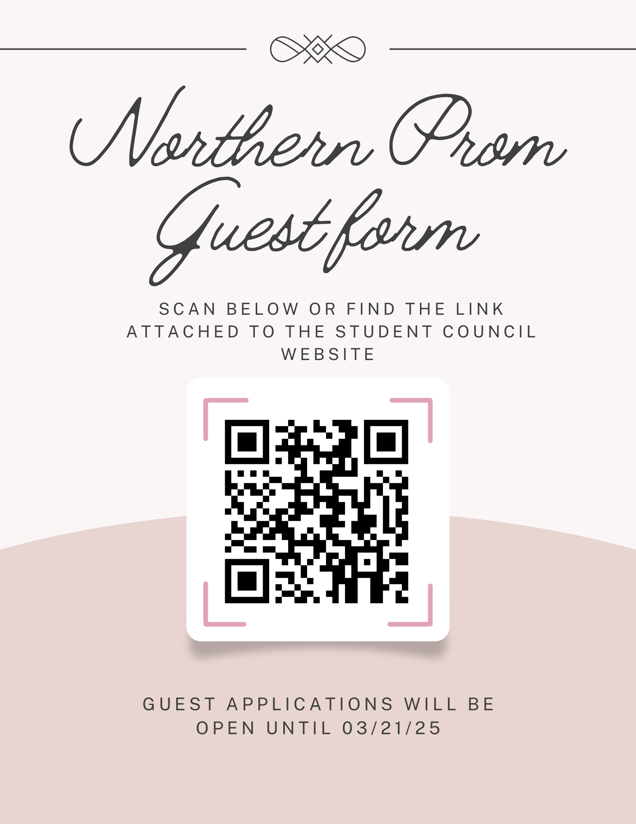

Slide 7
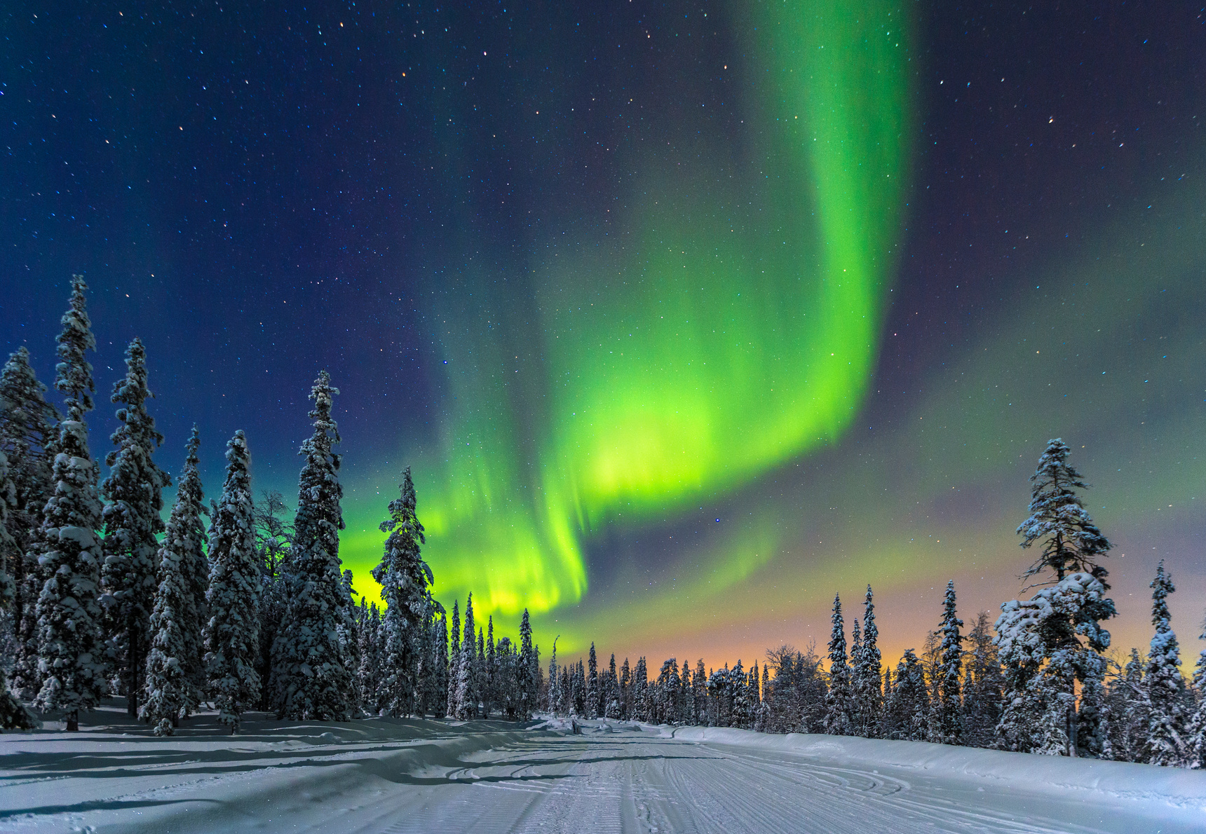
Decision Day Videos
(Due 4/21)
  Video yourself or have a friend video saying:
  Your name
  Where you attend high school, and
  Where you have been accepted or plan to attend college this fall (Military, Service Academies, and jobs count too)
  Example:
  “Hi, my name is ____________ from ______________ High School, and I’m proud to announce that I’ve been accepted to ___________ University (college, military, service academies, job) this fall.”
  ****Wear your college gear and hold up your acceptance letter.
  ****Email your video to: guthrik@gcsnc.com

Slide 8


Slide 9
Graduation Walks !
(May 2)
Schedule:
8am Departure from NGHS
815am Arrival (Summerfield Elementary)
845am Departure
9am Arrival (Northern Elementary)
930am Departure
945am Arrival (McNair Elementary)
1030am (Departure – Lunches starting)
1045/11am Arrival at NGHS
**** Permission slips due by April 11.

Slide 10

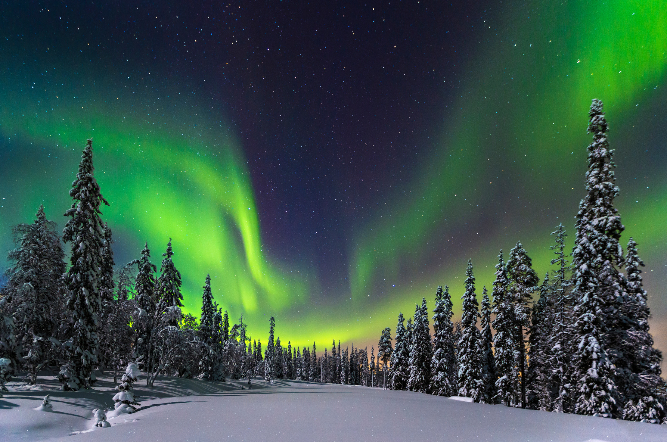

Slide 11
Senior Sunday - Awards – Picnic – Sunset ( June 1) Senior Awards at 5 p.m. in the NGHS Auditorium (seniors and families) Senior Picnic at 6:30 p.m. in the stadium (seniors and families) Senior Sunset at 8 p.m. in the stadium (seniors only) ***We need your pictures for a video for Senior Picnic-nghsseniorevents2025@gmail.com. Dances, Sport events, Socials, School time, etc. ***The event will be held, rain or shine, with alternate arrangements if needed due to weather conditions!

Slide 12
The Scholarship Newsletter is created each month as information on new scholarships is received.
*****Please visit the counseling department website on the latest information on scholarships.
Northern Scholarships:
Amanda Cullinan Scholarship is available to a graduating senior athlete - $2,500
Leslie Deaton Scholarship is available to a graduating senior with an unweighted 2.0 GPA
The Amanda Cullinan Foundation – Student-Athlete Resiliency Award
Amanda Cullinan, a devoted member of the Northern Community, loving wife and mother of three, passed away at the age of 43 after a 4-year battle with breast cancer.
Amanda wanted her one-time $2,500 award to be given to one college-bound student-athlete from Northern who has inspired others on or off the field.
If that describes you, please stop by the Counseling Office to pick up an application.
DUE: 4/23/2025

Slide 13
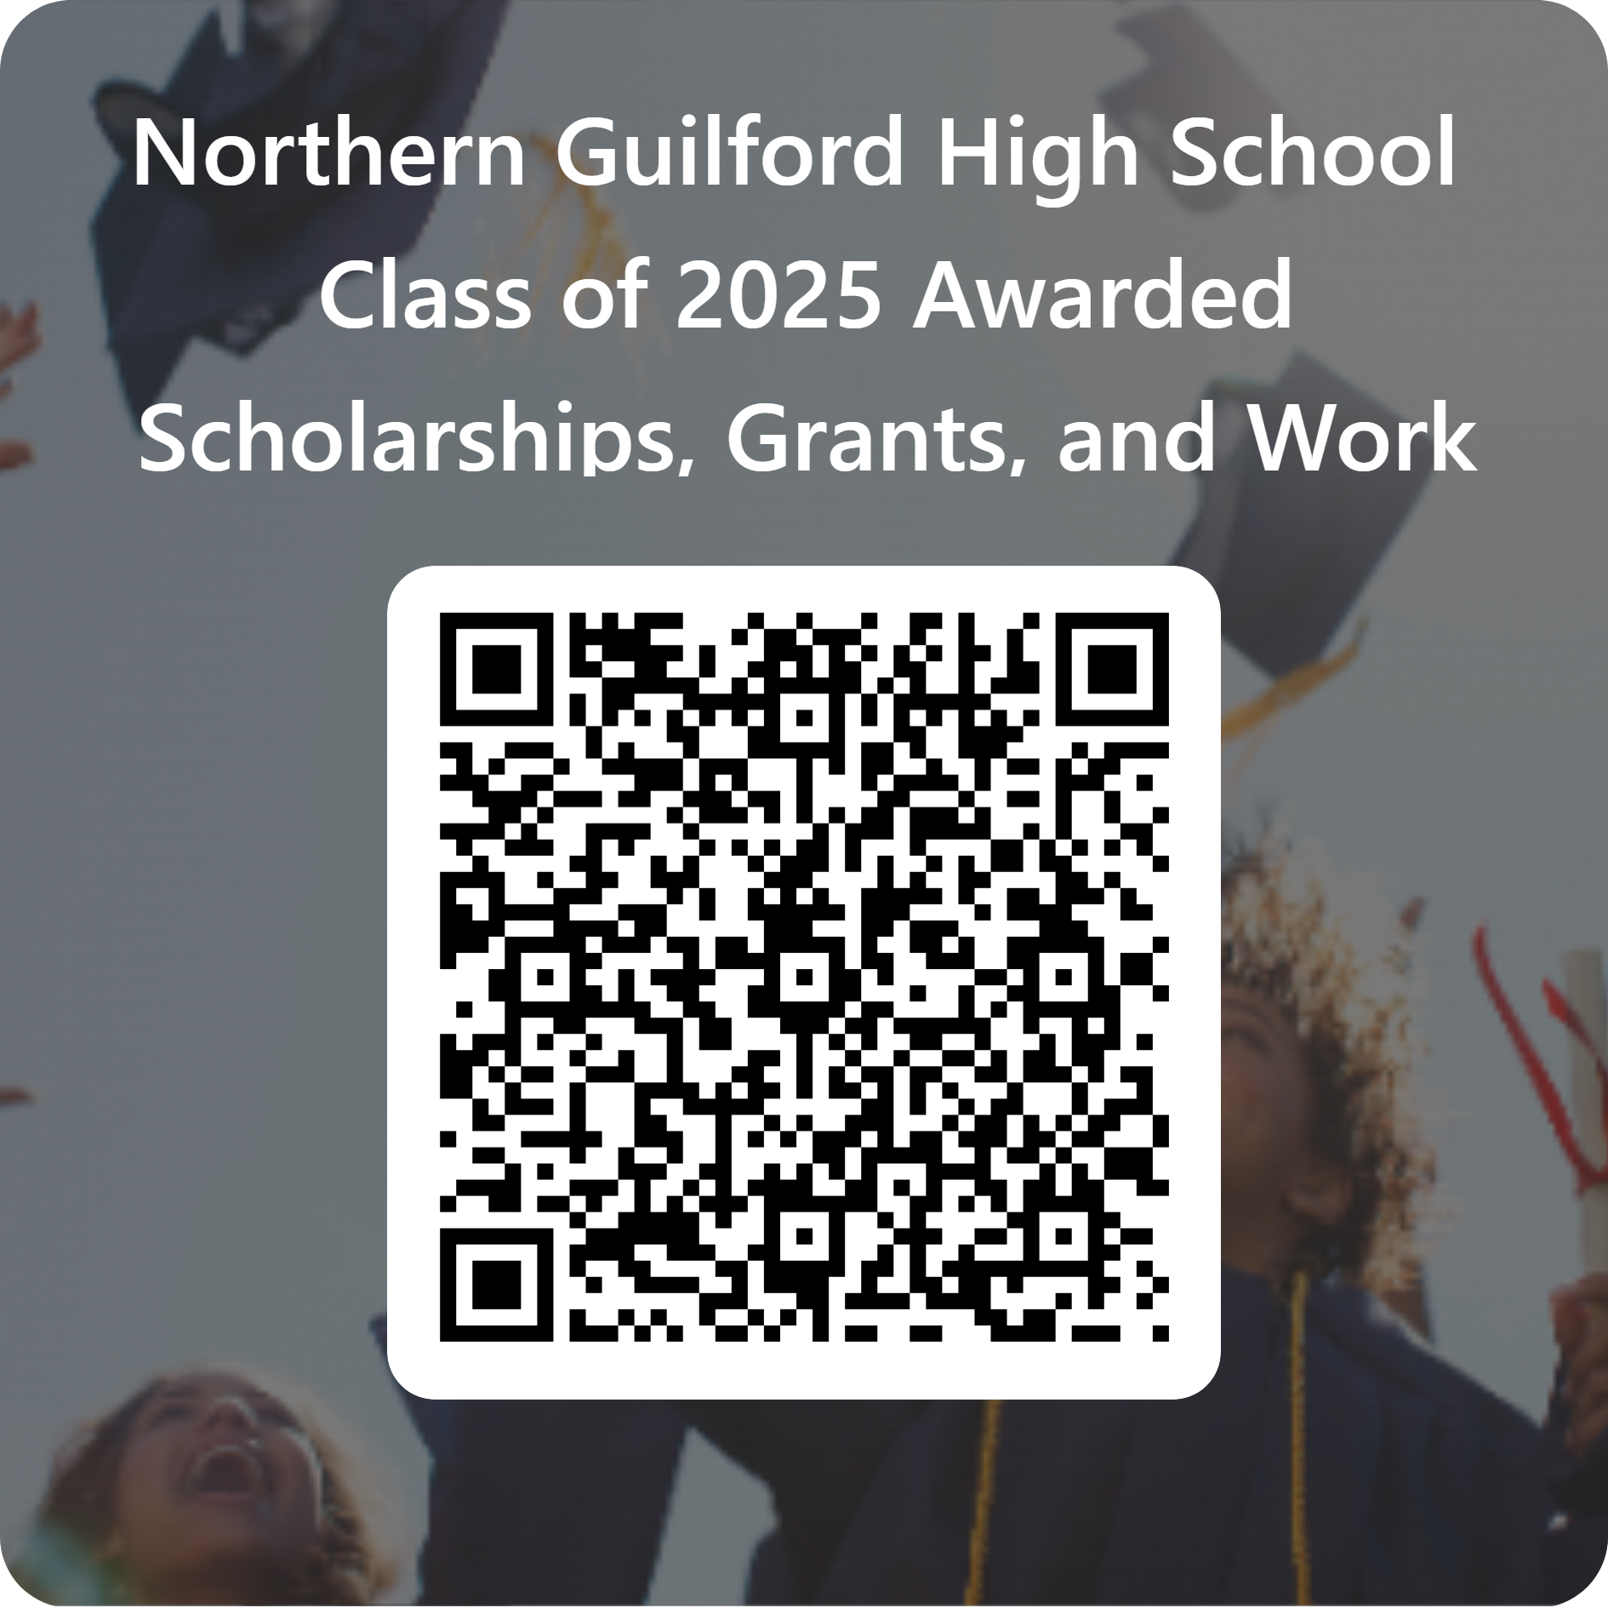

We want to celebrate with you!!
For more information about lots of scholarships
still available,
scan
the code

Slide 14
Post Graduation Plan We want to know what you plan to do when you graduate. Please fill out our Senior Post Graduation Plan Class of 2025 document and return it to Ms. Wyrick in the Counseling Office. (If you don’t want your post-graduate plans shared, please indicate that on your Senior Post Graduation Plan Class of 2025 document). - Join us on a field trip to GTCC this Thursday or Friday. Please sign up with Mrs. Smith. Students will have the chance to tour the campus, explore various programs, and network with professionals from a range of careers in the community. This is a valuable opportunity for anyone uncertain about his/her post-graduation plans.

Slide 15
GRADUATION !!!
◦Graduation Rehearsal – Tuesday, June 10 at 5 p.m. at the Greensboro Coliseum.
Students arrive at 4:15 p.m.
Dress casually with comfortable shoes
_________________________________________________
Graduation – Friday, June 13 at 9 a.m. at the Greensboro Coliseum.
Students arrive at 8 a.m.
Dress in graduation attire (cap and gown)
*****Students will receive 12 tickets each.*****

Slide 16
TRANSCRIPTS
◦For North Carolina colleges/universities students will request their transcripts through CFNC
◦For out of state colleges/universities students will request their transcripts through ScribOrder
◦For an unofficial copy students will request their transcript through ScribOrder and pick it up in the counseling office when it’s ready or have it emailed.
◦If you have taken a course(s) at GTCC through the Career & College Promise program, you will be required to send a GTCC transcript (in addition to your NGHS transcript) to the college you choose to attend.
**IF YOU APPLIED THROUGH COMMON APP, YOUR COUNSELOR UPLOADED YOUR INITIAL AND MID-YEAR TRANSCRIPTS.

Slide 17
Any Questions?
Email your counselor

Slide 18
WHO IS MY COUNSELOR?
A – E Mr. Demarcus Crawford
crawfod2@gcsnc.com
F - Li Mr. Karim Williams
williak19@gcsnc.com
Li - Ri Ms. Kathleen Elliott
elliotk@gcsnc.com
Ro – Z Ms. Kristin Guthrie Stuart
guthrik@gcsnc.com
Ms. Julie Cunningham
cunninj4@gcsnc.com

